Slide 1

Facebook Emotion Prediction
Florian Krebs, Bruno G. Lubascher, Tobias Moers, Pieter Schaap

Slide 2
Overview
1
Introduction
2
1. Research Goal
3
2. Research Goal
4
Conclusion
5
Contribution

Slide 3
Overview
1
Introduction
2
1. Research Goal
3
2. Research Goal
4
Conclusion
5
Contribution

Slide 4
Introduction
Facebook posts on a customer service page
Two datasets: Tesco and Sainsbury (supermarkets in Great Britain) of 2016
Understanding the experiences customers have
Differentiate between positive and negative posts
How the other customers react to the experience of the customer who wrote the post

Slide 5
Research Goals
Perform sentiment analysis on the posts.
In addition, Emotion Mining (maybe helps us with 2. goal)
Predict the distribution of user reactions.
Possible? Do the results make sense?
Predict the absolute value of user reactions.

Slide 6
Overview
1
Introduction
2
1. Research Goal
2.1
Approach
2.2
Results
3
2. Research Goal
4
Conclusion
5
Contribution

Slide 7
Overview
1
Introduction
2
1. Research Goal
2.1
Approach
2.2
Results
3
2. Research Goal
4
Conclusion
5
Contribution

Slide 8
Approach
Using Stanford CoreNLP to calculate sentiment for the post and comments
Techniques: tokenize, sentence-split, PoS-tagging, parse (full syntactic analysis), sentiment analysis
Using NRC Word-Emotion Association Lexicon (EmoLex: 14,182 words) to calculate emotion distribution for post and comments
Source: http://saifmohammad.com/WebPages/lexicons.html

Slide 9
Sentiment Analysis
CoreNLP calculates a sentiment for each sentence of the input
The sentiments are summed up and normalized by the number of the sentences
Ranges:
Negative: -2.0 to -0.5
Neutral: -0.5 to 0.5
Positive: 0.5 to 2.0

Slide 10
Emotion Mining
Emotion:
Anger, Anticipation, Disgust, Fear, Joy, Sadness, Surprise, Trust
Iterate over all words in article, sum emotions and normalize them
Lexicon-entry
"abuse": [1, 0, 1, 1, 0, 1, 0, 0]
"shopping": [0, 1, 0, 0, 1, 0, 1, 1]

Slide 11
Overview
1
Introduction
2
1. Research Goal
2.1
Approach
2.2
Results
3
2. Research Goal
4
Conclusion
5
Contribution

Slide 12
Sentiment and Emotion
Post: "Just want to say the staff at Tesco Express on Aberdour road, Dunfermline are fantastic. They are always so friendly and helpful and seem happy to work there!"
Sentiment: ["positive", 1.5]
Emotion: [JOY: 37,5%, 'TRUST: 37,5%']

Slide 13
Overview
1
Introduction
2
1. Research Goal
3
2. Research Goal
3.1
Approach
3.2
Experiments
4
Conclusion
5
Contribution

Slide 14
Overview
1
Introduction
2
1. Research Goal
3
2. Research Goal
3.1
Approach
3.2
Experiments
4
Conclusion
5
Contribution

Slide 15
Approach
Pre-processing
Filtering posts
Duplicate Characters
Classification
Recurrent Neural Network (RNN)
Convolutional Neural Network (CNN)

Slide 16






Models - RNN
RNN
I
Love
To
Shop
At
Tesco
!
LSTM cell
Dropout
Word
Embedding
LSTM cell
Dropout
Softmax
LSTM cell
Word embedding size : 50
LSTM cells : 128
LSTM layers : 1
Dropout probability : 0.5

Slide 17
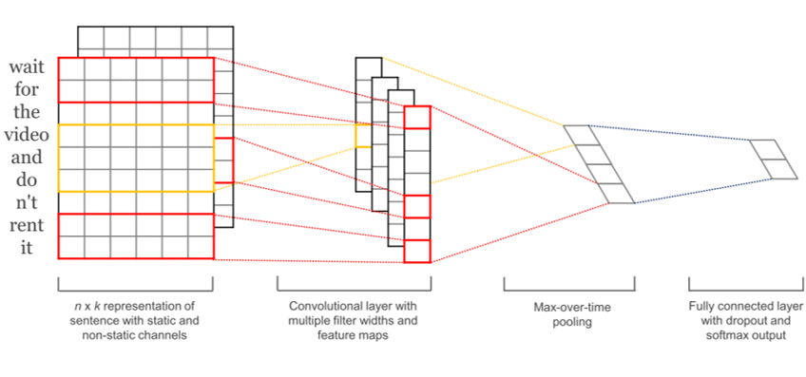
Models - CNN
Parameters:
Word embedding size: 50
Filter sizes : 3,4,5 words
Number of each filter: 40
Dropout probability: 0.5
Source: Kim, Y. (2014). Convolutional neural networks for sentence classification. CoRR, abs/1408.5882.

Slide 18
Overview
1
Introduction
2
1. Research Goal
3
2. Research Goal
3.1
Approach
3.2
Experiments
4
Conclusion
5
Contribution

Slide 19
Experiments
Raw input vs pre-processed input
Data size comparison
Compare different filtering criteria
Minimum number of reactions
Ignore likes

Slide 20
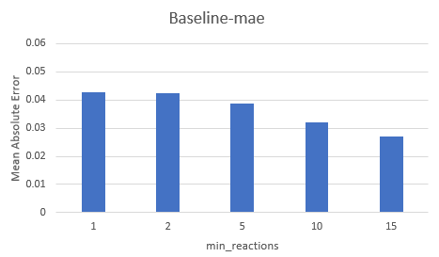
Experiments Baseline
Only predict likes

Slide 21
Filter: Minimum number of reactions
Goal: Use only those posts for training that have a certain amount of total reactions (e.g. 15)
Setup:
Filter for all posts in the DB that have the required amount of total reactions
Give some information about the size of the filtered data
Hypothesis: The higher the amount of reactions the more meaningful are the distributions of those posts. The drawback of this method is the reduced amount of training data

Slide 22
Filter: Minimum number of reactions
Results:
When using posts with at least 15 total reactions only ~200 Posts are left
When using the additional crawled material we still only got around ~475 posts
Those are way too less to train a NN efficiently

Slide 23
Raw input vs pre-processed input
Goal: check the effect that the pre-processing has on the accuracy of the model.
Setup: Train a model with raw-data as input and compare it to the model trained with pre-processed data.
Hypothesis: pre-processed input should outperform the raw input.
Pre-processing decreases the corpus’s vocabulary.
Pre-processing should decrease noise created by typo’s and character repetition.

Slide 24
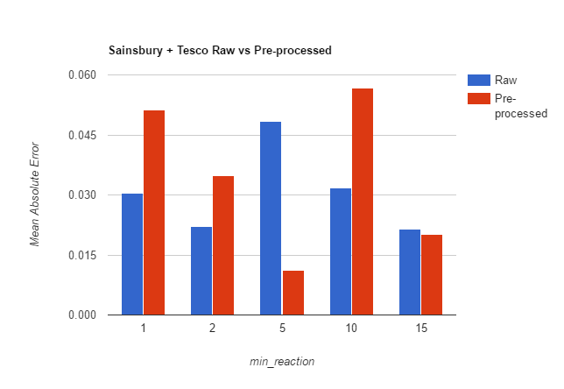
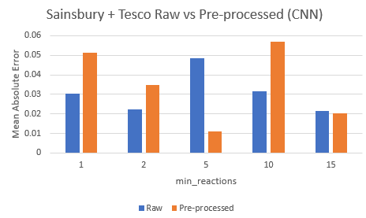
Raw input vs pre-processed input
Results CNN
Pre-processing overall increases error.
Sensitive to fewer word variance.

Slide 25
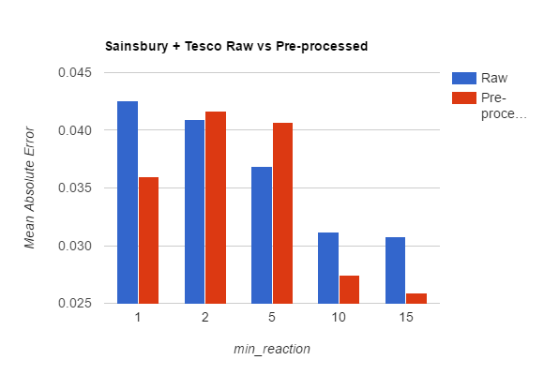
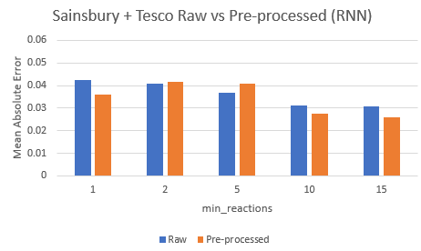
Raw input vs pre-processed input
Results RNN
Pre-processing helped to decrease error.
More robust to fewer word variance.

Slide 26
Data size comparison
Goal: original dataset small after filtering → more data may be needed.
Setup:
Scrape more data
Train additional model
Compare accuracy
Hypothesis: More data should decrease the chance of overfitting and thus the overall accuracy should increase.

Slide 27
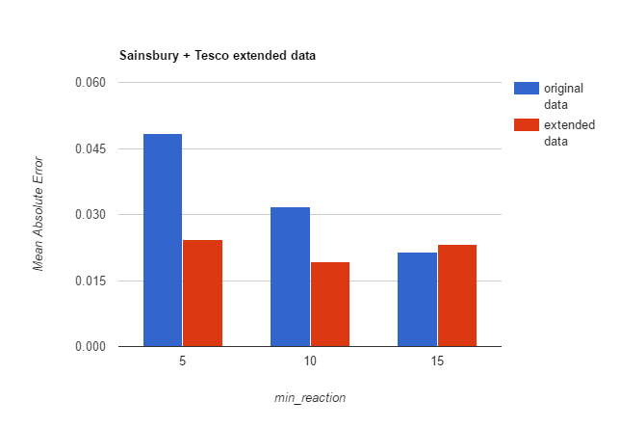
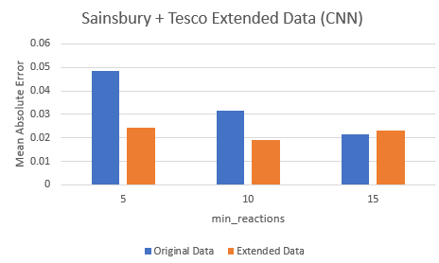
Data size comparison
Results CNN
Adding more data increases accuracy.
Due to limited data the CNN overfits.

Slide 28
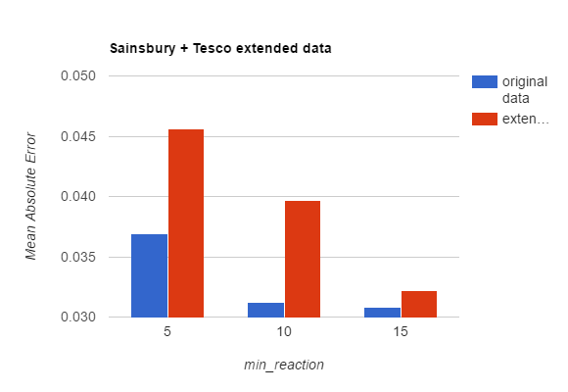
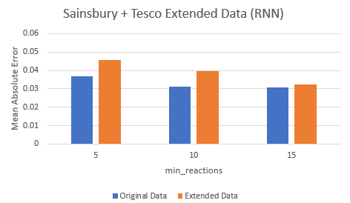
Data size comparison
Results RNN
The extra data increased error.
The experiments ran for the same amount of time steps. With more data, the time was not enough for a good fit.

Slide 29
Filter: Ignore likes
Goal: Remove likes from training data to reduce the problem of poorly distributed data
Setup:
Get all posts from DB but ignore/remove the likes from the distribution when training the model
Hypothesis: The accuracy of the reactions' predictions should increase since the distribution is now more consistent

Slide 30
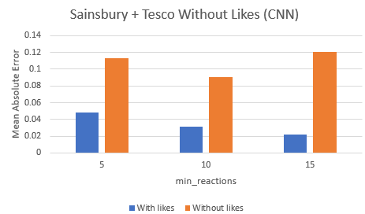
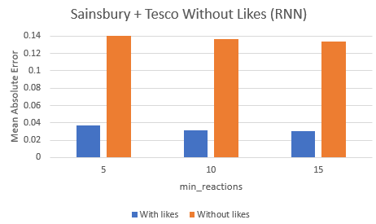
Filter: Ignore likes
Results CNN/RNN
Discarding likes decreases accuracy. Simple explanation: Like ratio close to 1 Always predicting likes to be 100% will lead to lower errors but carry little information.

Slide 31
Overview
1
Introduction
2
1. Research Goal
3
2. Research Goal
4
Conclusion
5
Contribution

Slide 32
Progress: Data
Data stored in one central place (MongoDB)
Data easier to access with DB-tools
Added own Facebook-parser
Already crawled additional data
We still have too less "good" data

Slide 33
Progress: Research goal 1
Added sentiment analysis
Added emotion mining
The results of emotion mining are not yet used in the prediction of reactions
We need to analyze the dependency between emotions and reactions

Slide 34
Progress: Research goal 2
First implementation of RNN and CNN
CNN results are not that good yet
Maybe add additional data?
There are still a lot of experiments left
e.g. can we improve the predictions with pre-trained word embeddings?

Slide 35
Overview
1
Introduction
2
1. Research Goal
3
2. Research Goal
4
Conclusion
5
Contribution

Slide 36
Contribution – Period 5
Tobias:
CNN, Sentiment analysis and Emotion Mining, experiments, presentation, research
Florian:
Sentiment analysis and Emotion Mining, data crawling, presentation
Bruno:
RNN, experiments, presentation
Pieter:
Data filtering, presentation

Slide 37
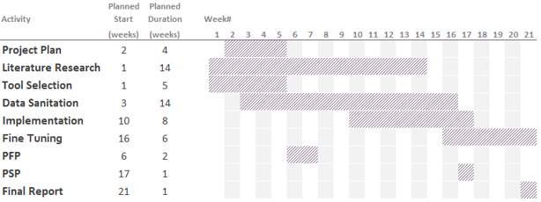
Planning – Period 6

Slide 38
References
Perez-Ortiz, J. A., Calera-Rubio, J., and Forcada, M. L. (2001). Online text prediction with recurrent neural networks. Neural Processing Letters, 12:127-140.
Rehurek, R. and Sojka, P. (2010). Software Framework for Topic Modelling with Large Corpora. In Proceedings of the LREC 2010 Workshop on New Challenges for NLP Frameworks, pages 45-50, Valletta, Malta. ELRA. http://is.muni.cz/publication/884893/en.
Schare, F. (2017). Word2Vec pretrained models.
Sun, S., Luo, C., and Chen, J. (2016). A review of natural language processing techniques for opinion mining systems. Elsevier, 34:10-25.
Zhang, L. and Liu, B. (2014). Aspect and Entity Extraction for Opinion Mining, pages 1-40. Springer Berlin Heidelberg, Berlin, Heidelberg.
Arathi, M. Solving text imputation using recurrent neural networks.
Facebook (2016). Reactions now available globally. http://newsroom.fb.com/news/2016/02/reactions-now-available-globally/. Accessed: 2017-03-14.
Fan, W. and Gordon, M. D. (2014). The power of social media analytics. Commun. ACM, 57(6):74{81.
Kalchbrenner, N., Grefenstette, E., and Blunsom, P. (2014). A convolutional neural network for modelling sentences. CoRR, abs/1404.2188.
Kim, Y. (2014). Convolutional neural networks for sentence classication. CoRR, abs/1408.5882.
Klec, M. (2012). Sparse autoencoders in sentiment analysis. PolTAL '14, Warsaw, Poland.
Lai, S., Xu, L., Liu, K., and Zhao, J. (2015). Recurrent convolutional neural networks for text classication.

Slide 39
Questions?

